Slide 1









Welcome to Foodify!

Slide 2

INTRODUCTION

Slide 3


INTRODUCTION
Foodify is a revolutionary website that allows college students to order food items from campus canteen with ease. Our website makes it easy for you to browse menus. Our platform is designed to make the ordering process simple and hassle-free, allowing students to focus on their studies while still enjoying delicious meals from the canteen. We understand the busy schedules of college students and strive to provide a convenient and efficient service. Our team is dedicated to providing the best customer service and ensuring that all orders are delivered on time and to the highest quality. With Foodify, you can say goodbye to long lines and crowded canteens and hello to a seamless and satisfying food ordering experience.

Slide 4

WEBSITE

Slide 5
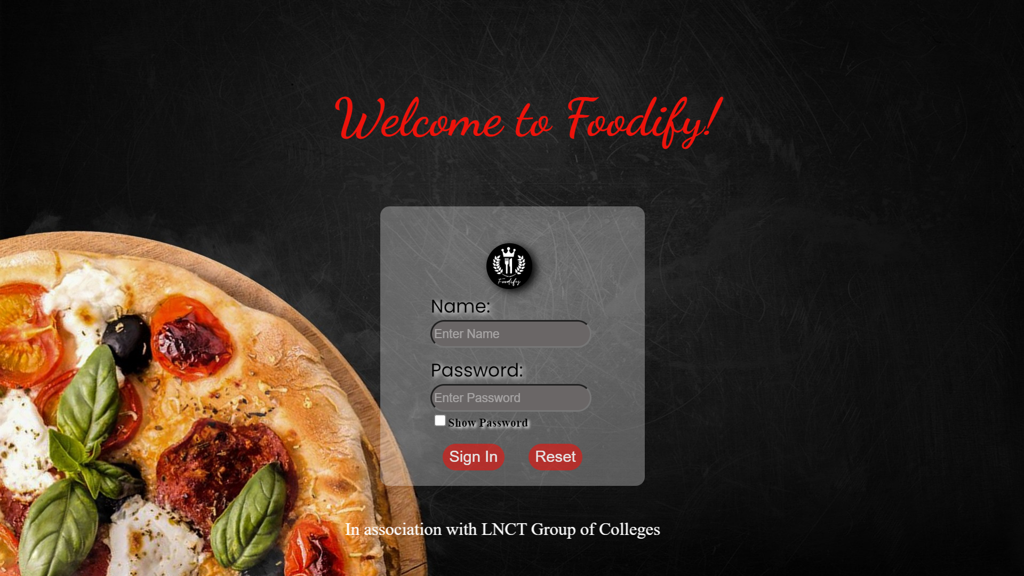

Slide 6
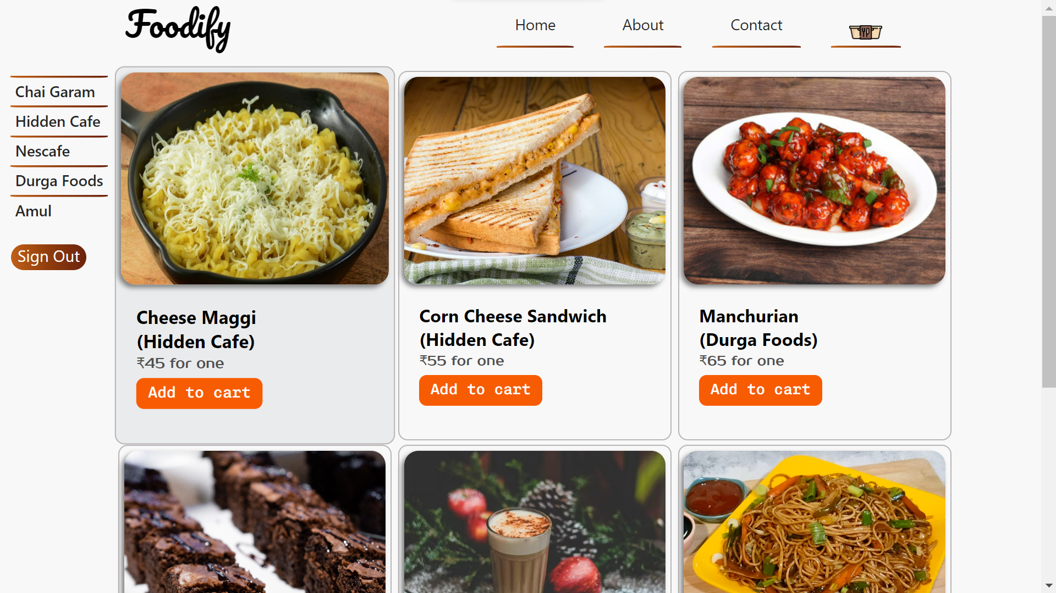

Slide 7
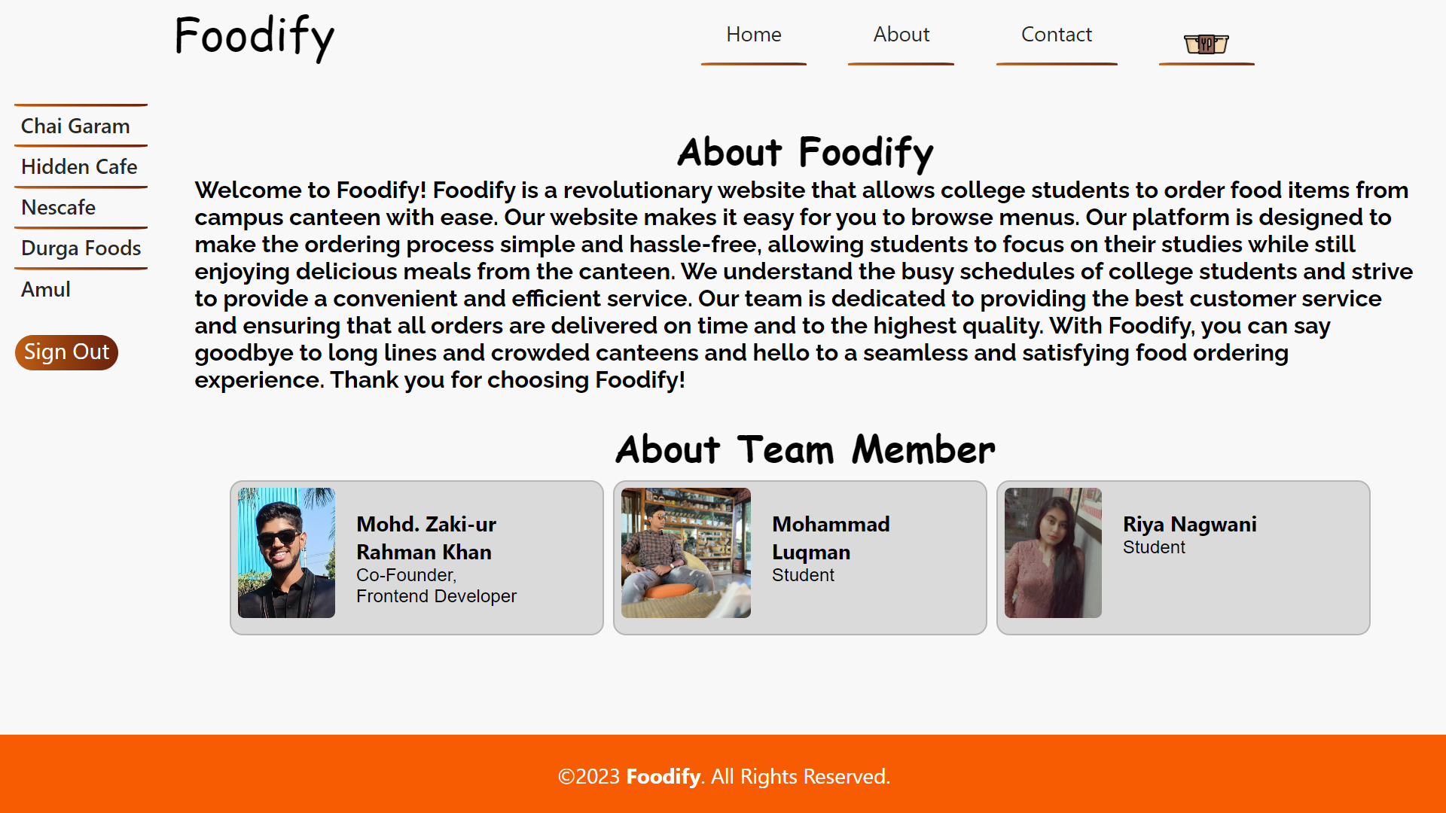

Slide 8
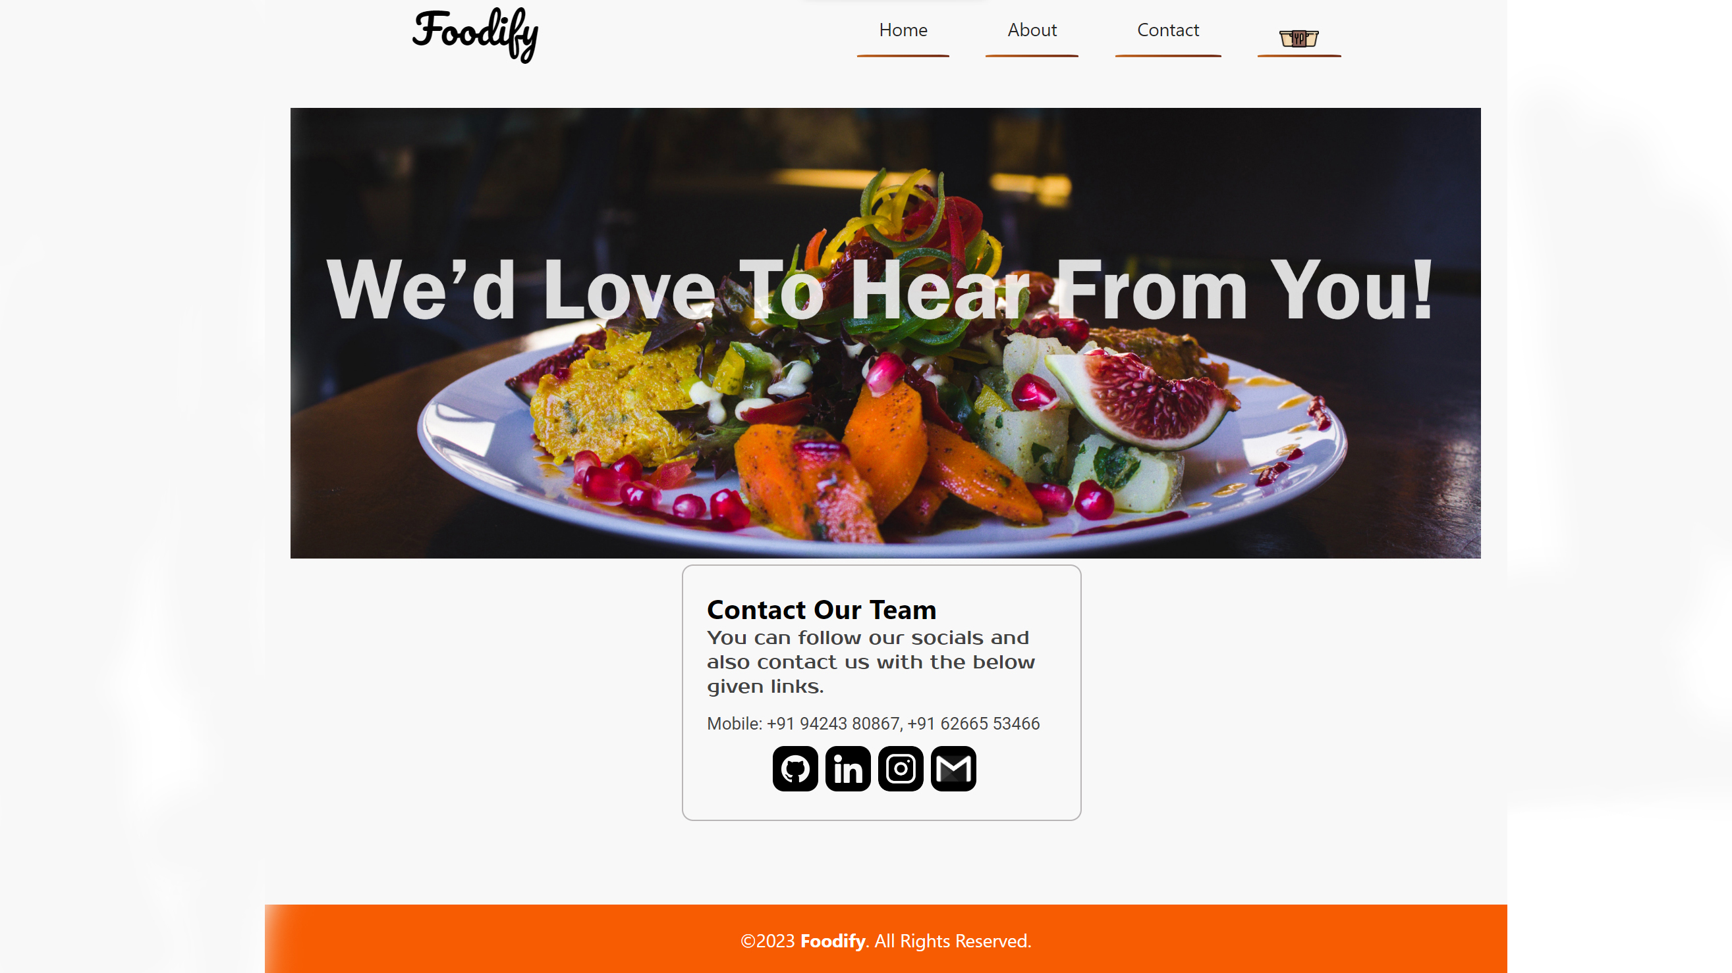

Slide 9

PROGRAMMING LANGUAGES USED

Slide 10
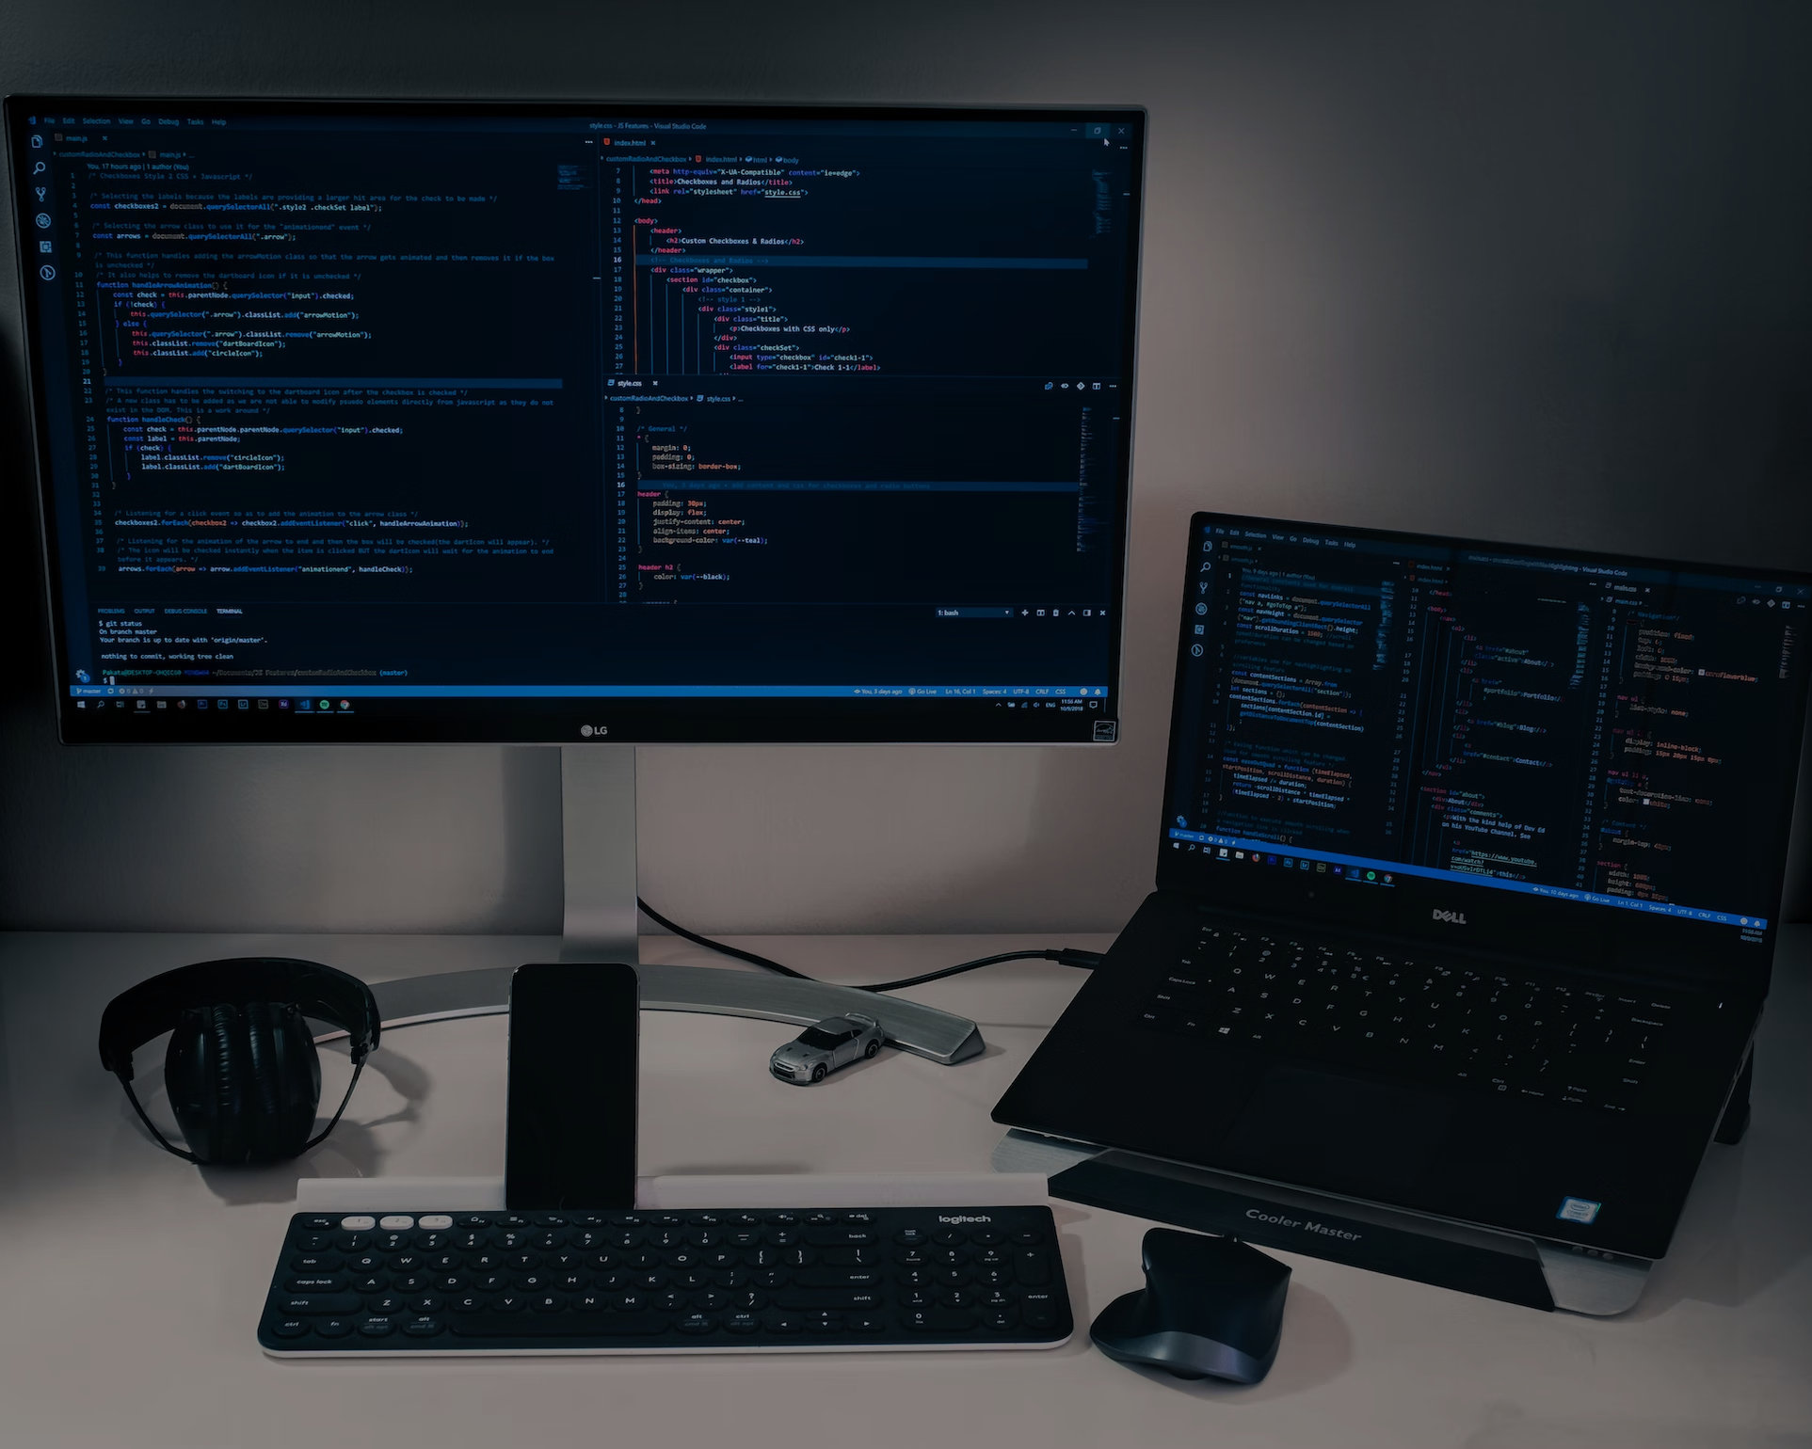
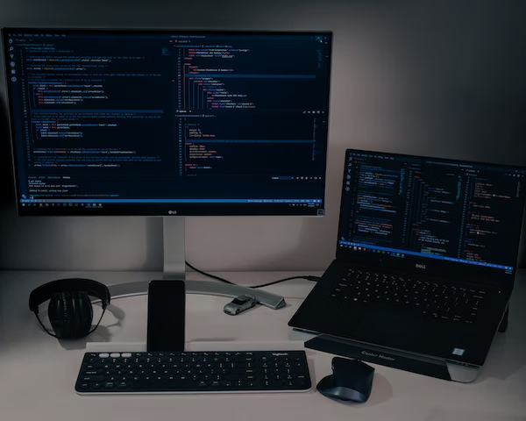




PROGRAMMING LANGUAGES USED

Slide 11
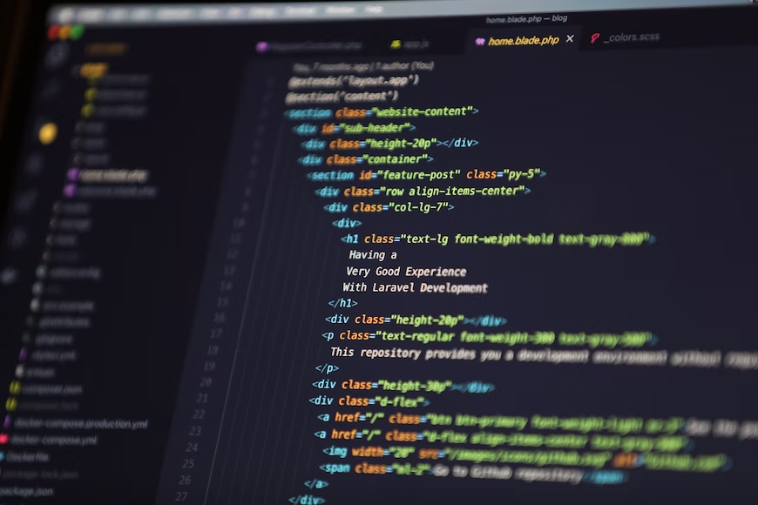


Slide 12


The HyperText Markup Language or HTML is the standard markup language for documents designed to be displayed in a web browser. Web browsers receive HTML documents from a web server or from local storage and render the documents into multimedia web pages. HTML describes the structure of a web page semantically and originally included cues for the appearance of the document. HTML elements are the building blocks of HTML pages. With HTML constructs, images and other objects such as interactive forms may be embedded into the rendered page.

Slide 13


Slide 14



Cascading Style Sheets (CSS) is a style sheet language used for describing the presentation of a document written in a markup language such as HTML or XML CSS is a cornerstone technology of the World Wide Web, alongside HTML and JavaScript. CSS is designed to enable the separation of content and presentation, including layout, colors, and fonts. This separation can improve content accessibility; provide more flexibility and control in the specification of presentation characteristics; enable multiple web pages to share formatting by specifying the relevant CSS in a separate .css file, which reduces complexity and repetition in the structural content.

Slide 15

<body>
<div id="amul-menu">
<a href=“Images/amul.jpg" target="_blank">
<img class="amul bdr-menu" src="Images/amul.jpg" alt="amul-menu">
</a><br>
<a href=“Images/amul2.jpg" target="_blank">
<img class="amul bdr-menu" src="Images/amul2.jpg" alt="amul-menu"></a>
</div>
<p id="p-amul-menu">
<img src="https://cdn-icons-png.flaticon.com/512/3144/3144456.png" height="50px" width="50px" alt="cart">
<br> You can place orders soon.
</p>
</body>
.amul{
margin-top: 20px;
margin-left: 20px;
height: 450px;
width: 250px;}
.amul:hover{transform: scale(1.05);}
#amul-menu{
display: flex;
flex-flow: row wrap;
}
#p-amul-menu{
margin-top: 15%;
margin-left: 5%;
font-size: 20px;
font-weight: bold;
}
.bdr-menu{
border-top-left-radius: 15px;
border-top-right-radius: 15px;
border-bottom-left-radius: 15px;
border-bottom-right-radius: 15px;}

Slide 16

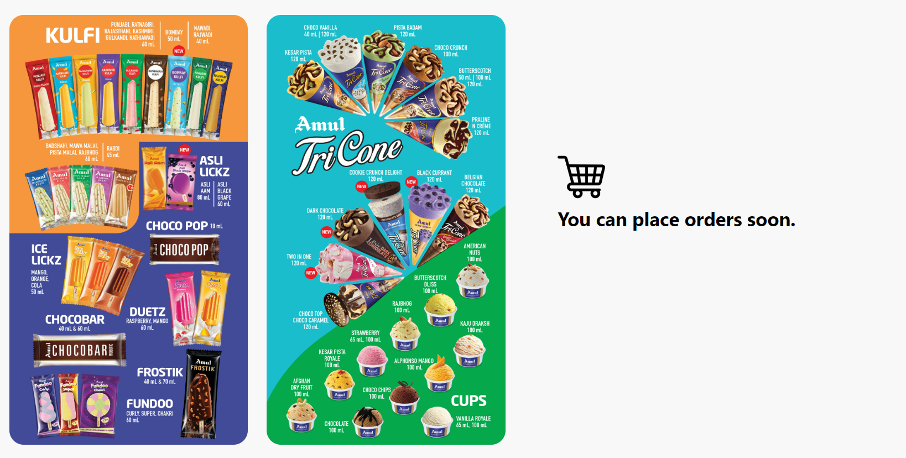
OUTPUT

Slide 17

HARDWARE & SOFTWARE REQUIREMENTS

Slide 18


HARDWARE & SOFTWARE REQUIREMENTS
HARDWARE REQUIREMENTS:
SOFTWARE REQUIREMENTS:
Processor: Minimum 1GHz
LAN Connection or Wi-Fi
Hard Drive: 32GB
RAM: Minimum 4GB
Sound Card with Speakers
Sometimes camera and mic
Any web browser that works best on your PC. Some Examples:
Google Chrome
Firefox
Internet Explorer

Slide 19
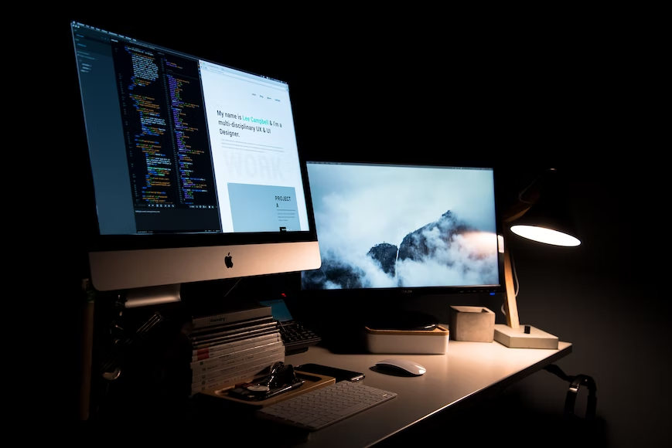
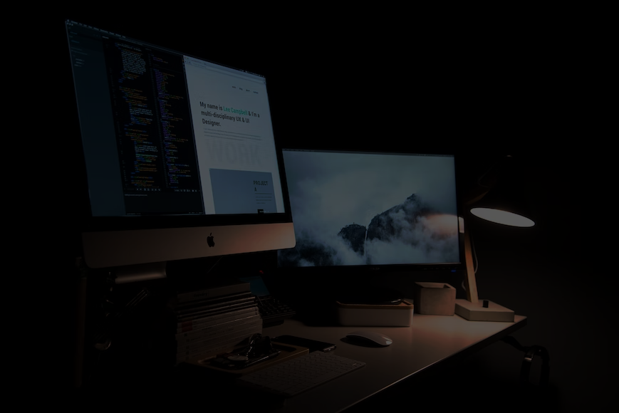
THANK YOU!
TEAM MEMBERS:
Mohammad Luqman
Mohd. Zaki
Riya Nagwani

